Slide 1
PEOPLE ANALYTICS
Tran Anh Tuan

Slide 2


PEOPLE ANALYTICS
Top Down Approach Using Xmind
Design UI Dashboard Using Visily
Power BI Using Power BI follow UI & Xmind

Slide 3
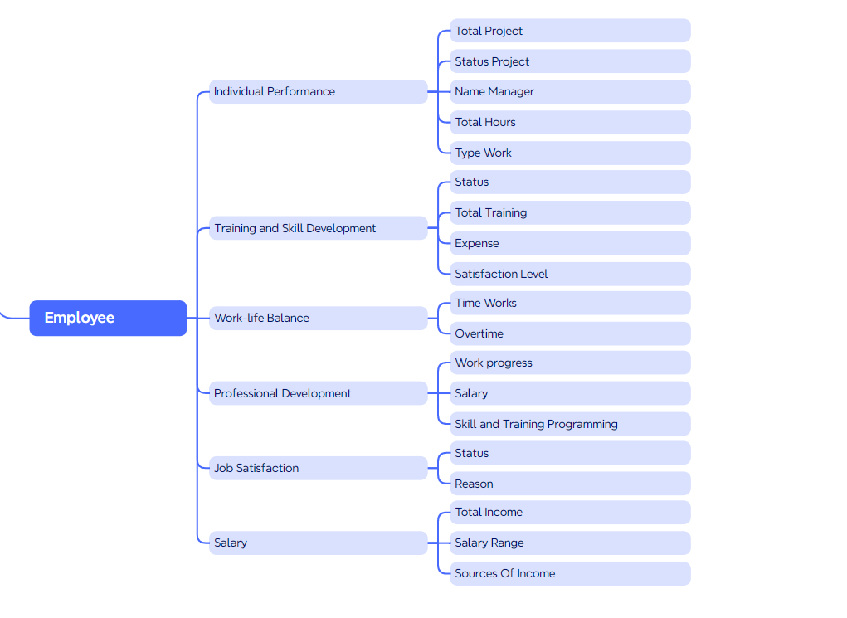
TOP DOWN APPROACH - Employee

Slide 4
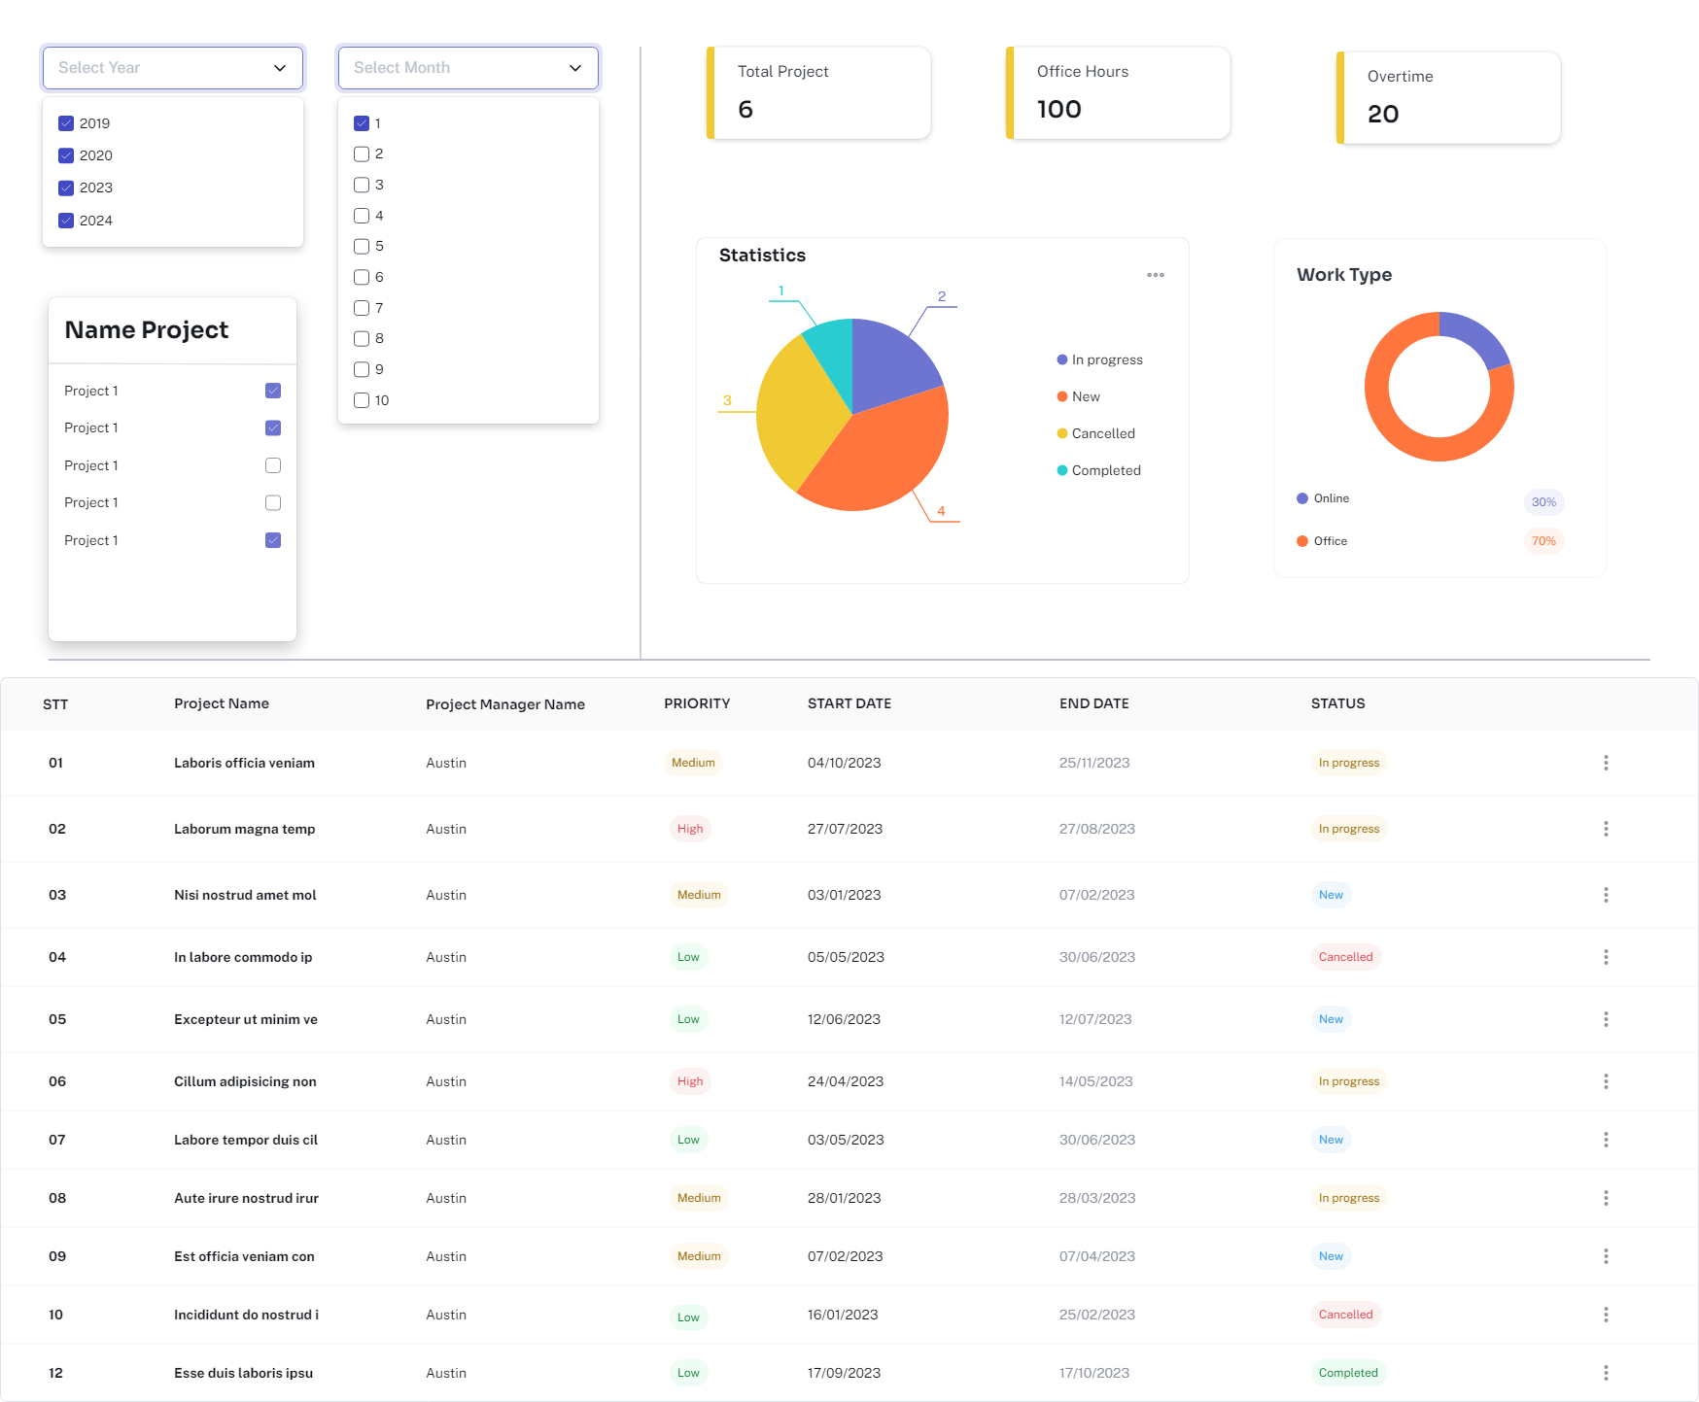
DESIGN UI DASHBOARD - Employee Performance

Slide 5
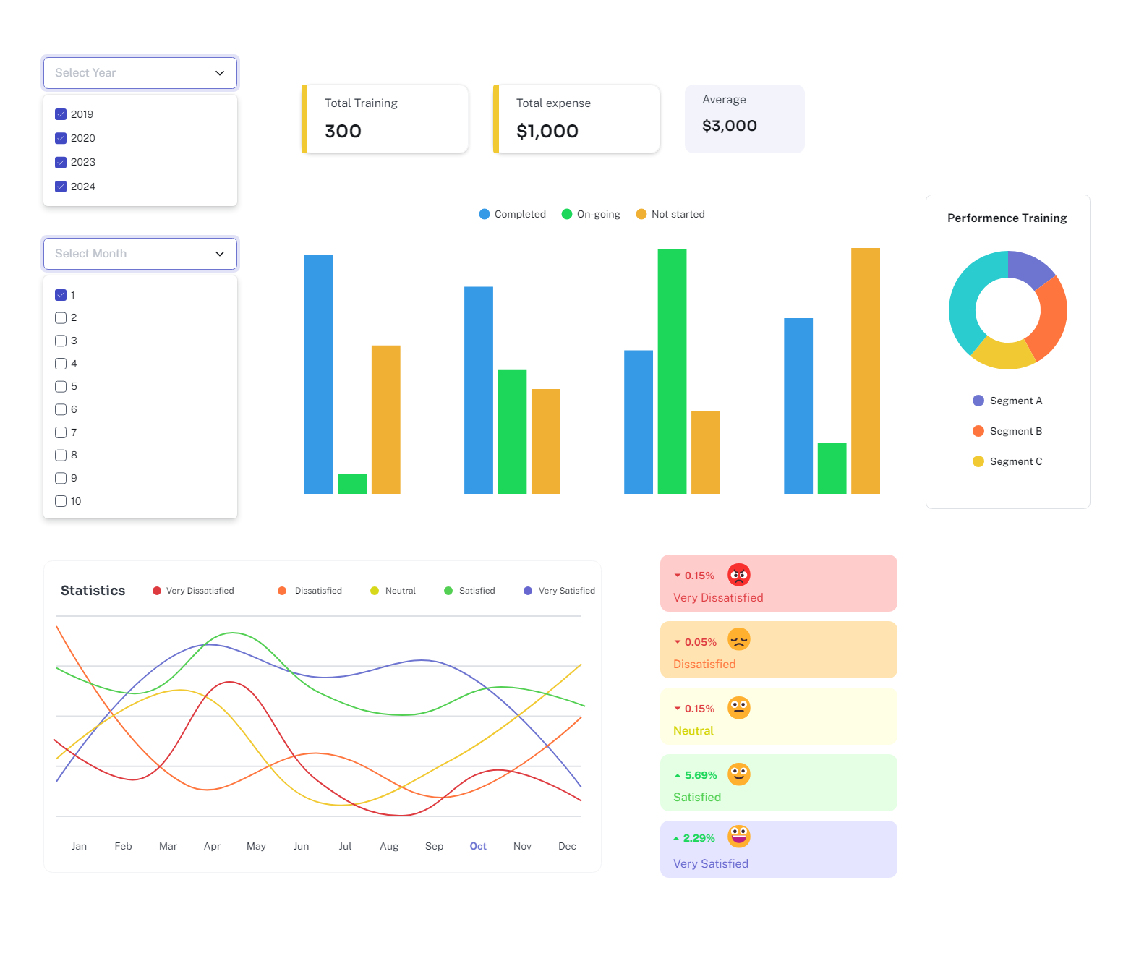
DESIGN UI DASHBOARD - Training and Development

Slide 6
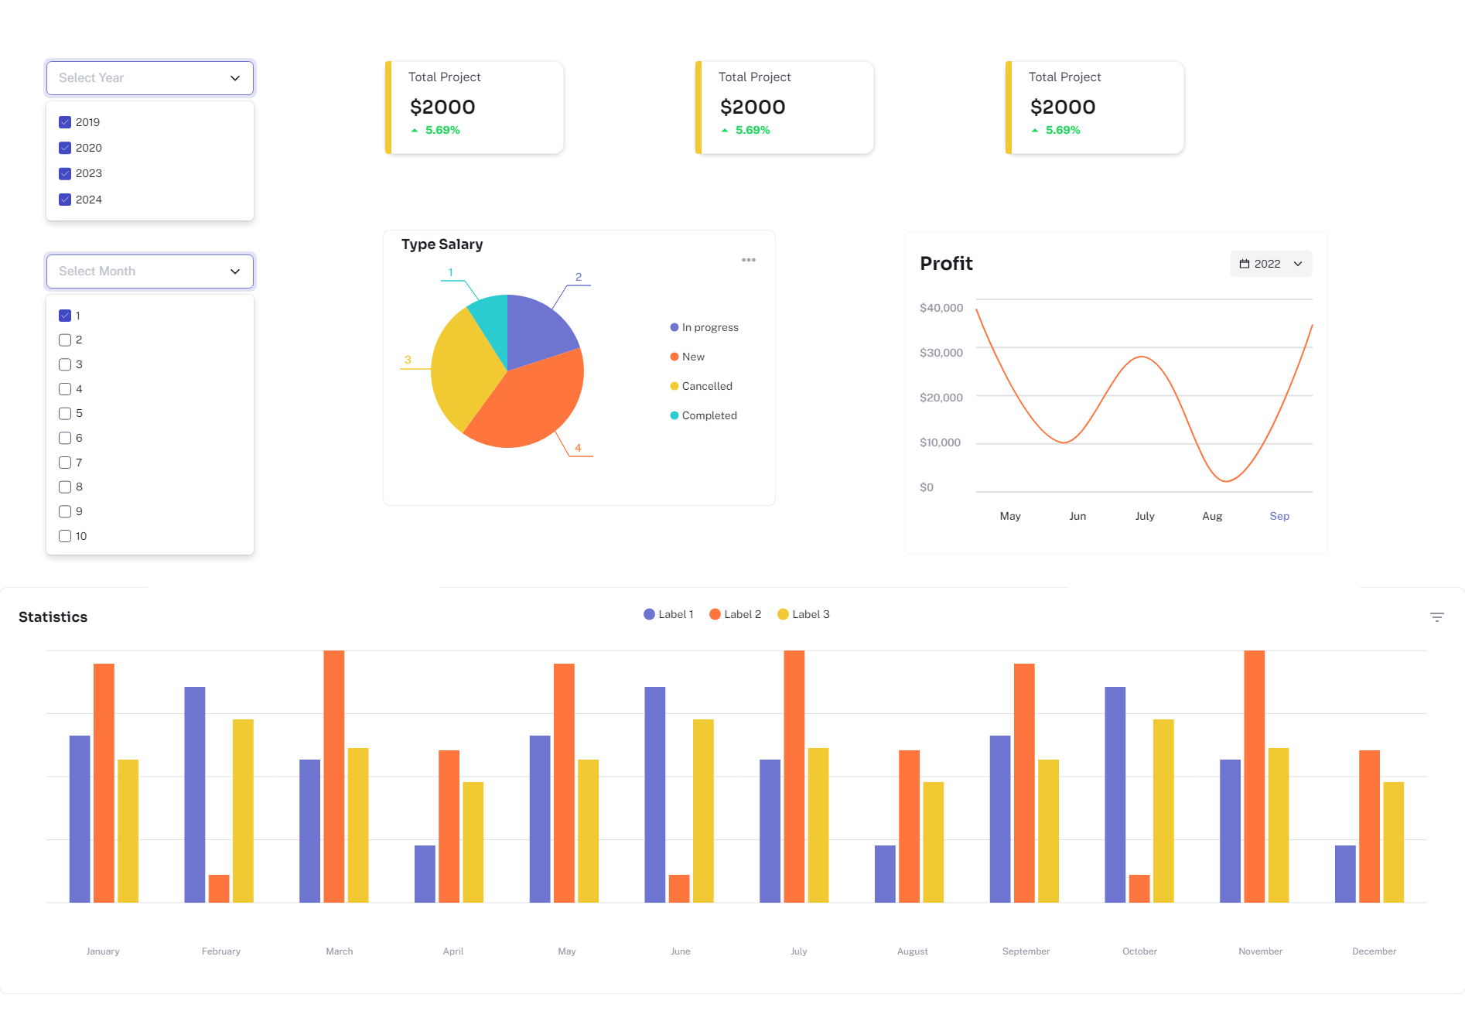
DESIGN UI DASHBOARD - Salary

Slide 7
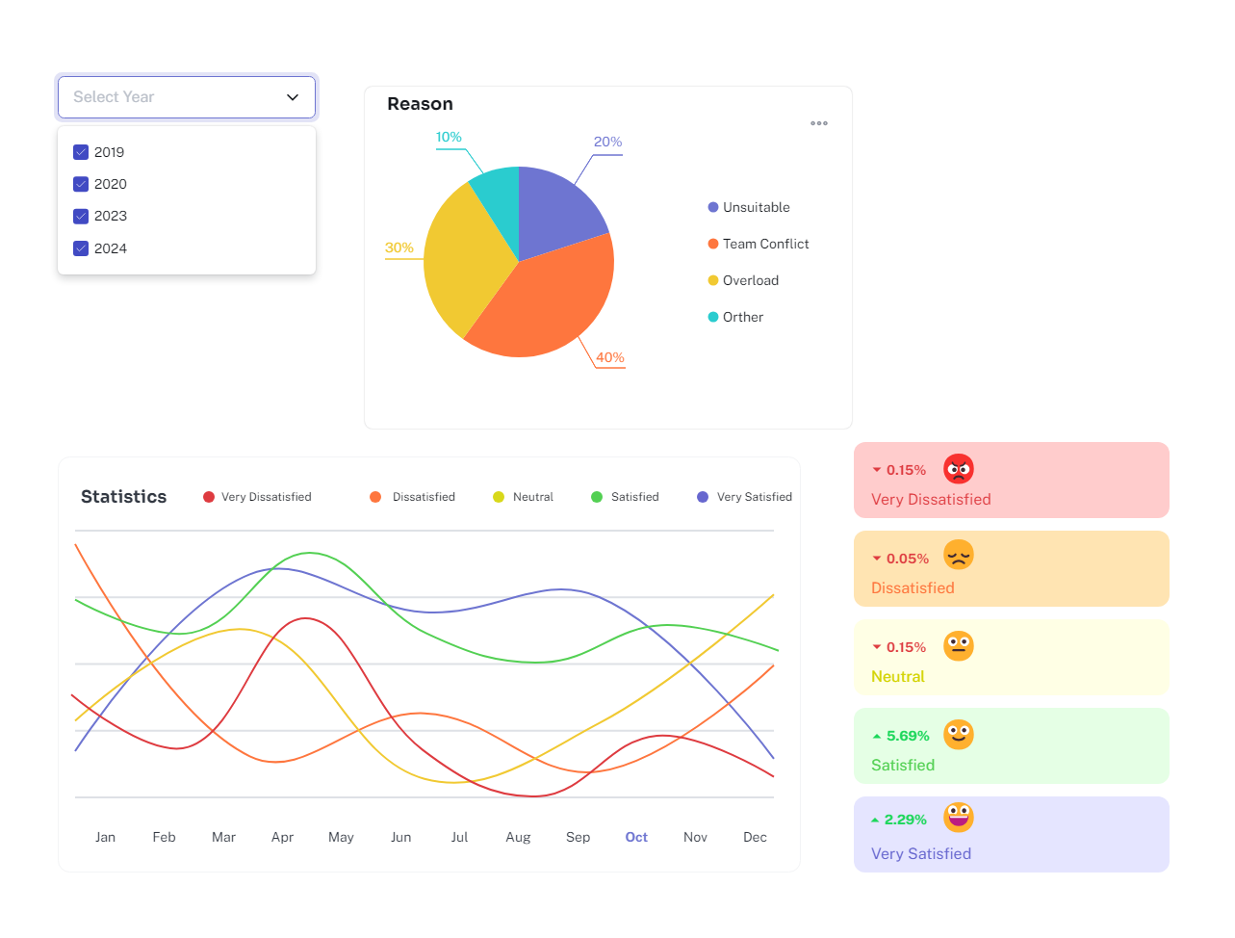
DESIGN UI DASHBOARD - Job Satisfaction

